Slide 1

Picking the Right SEO Tools
Kubilay Cagatay
WEB 225

Slide 2

“Batman has his utility belt, generals have their massive armies, and as you are about to find out, SEOs have browser extensions and nifty websites.”

Slide 3


Querying search engines
A search query report shows queries for which your site appears in search results, along with estimates about how many times you get the click.
It also shows your page’s “average position,” which is the average rank for your site for a given query. While the impression and click numbers appear to be rounded estimates, they provide good insight into areas in which a little extra focus can provide additional traffic.
Useful commands to use when searching filtering search results to show only pages that contain certain attributes.
cache:
site:
inurl:
intitle:

Slide 4

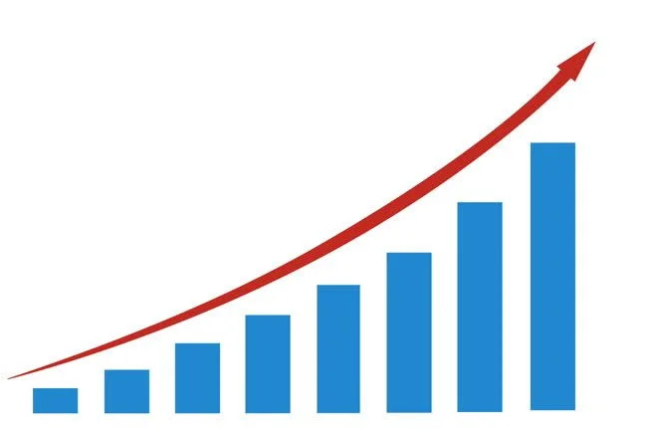
Leveraging search engine tools
The two most popular search engine-provided tools are:
Google AdWords Keyword Tool: With Google AdWords Keyword Tool you can see Google specific information about how many monthly searches are performed on a given term. This is extremely useful for conducting keyword research and deciding which word a given page should target.
Google Webmaster Central: This allows you to set specific settings for your website as well as see specific metrics of how Google sees your website. These metrics include link profile details and crawling statistics.

Slide 5

Using relevancy determining tools
SEO companies have developed tools to help make determining relevancy easier. The big three: Dave Naylor’s Keyword Density Tool, SEOmoz’s Term Target Tool, and Ranks.nl Keyword Density & Prominence Analyzer. These tools…
See how relevant a page is to a specific keyword
Save time while building client reports (I use the data from these
tools in my reports)
Gain a search engine crawler perspective on a webpage

Slide 6
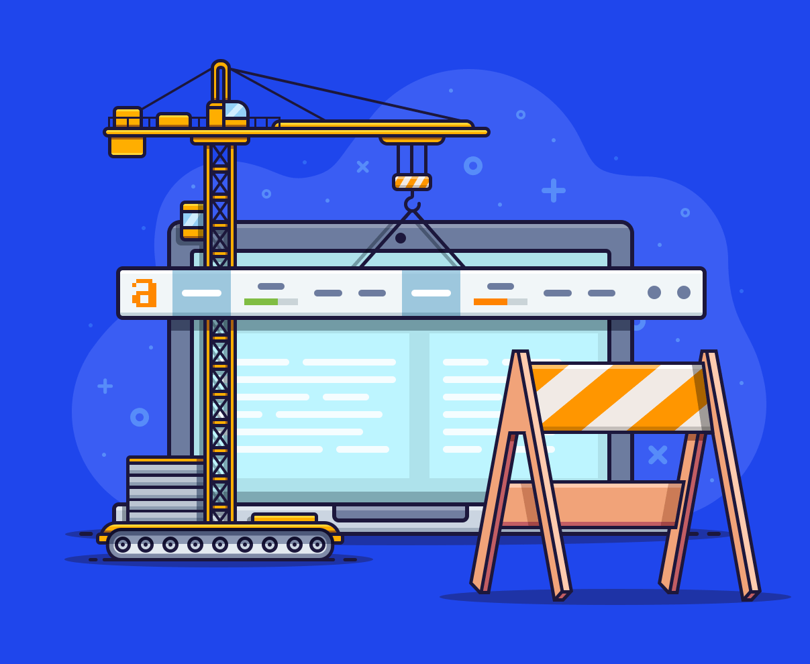
Analyzing webpages with SEO toolbars
SEO toolbars are faster than traditional SEO tools (they run every page load) and can pack a surprising amount of information into their small space. The big two: SEO for Firefox and the mozBar. These help…
Quickly see the SEO-related properties of a webpage
Get a context for a webpage on a domain
Get a context for a domain on the Internet

Slide 7

Using the HTTP Header Analyzer
The HTTP Header Analyzer should be used when someone wants to:
Know whether a redirect is a 301 or a 302
Know all of the nodes in a redirect chain
Some key data points that this brings up are:
HTTP Status Code
All files being downloaded from a page

Slide 8

Switching user agents
As you surf around the Internet, your browser sends information to each server it connects to. One of these pieces of information is its user-agent string. Based on this, the website will choose specific versions of their content to send you. When you want to access non-personalized sites, you can switch your user agent using Firefox User Agent Switcher. This will let you:
Search for evidence of cloaking content based on user agent
Access a website that filters out standard user agents

Slide 9


Viewing websites from a search engine perspective
Remember that not all of your optimization should be aimed at search engine algorithms. In order to be successful, you need to optimize for the people that are going to read the search results that you optimize.
However, you do still need to take into account how Google (search engines) see your website. Google Webmaster Toolset (GWT) is an excellent way of gathering Google-specific data about your site’s performance and finding potential obstacles to Google viewing the site correctly.

Slide 10

Thank you!

